Slide 1
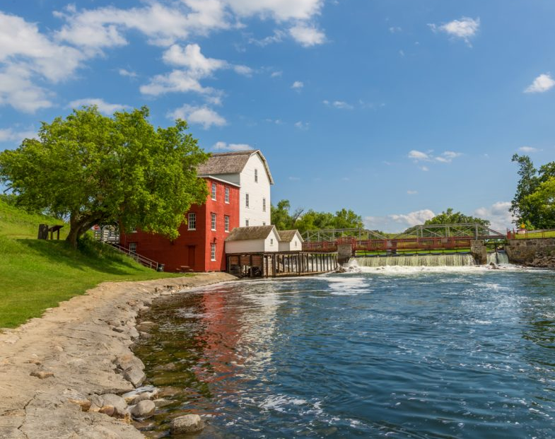
Phelps Mill County Park Master Plan

Slide 2
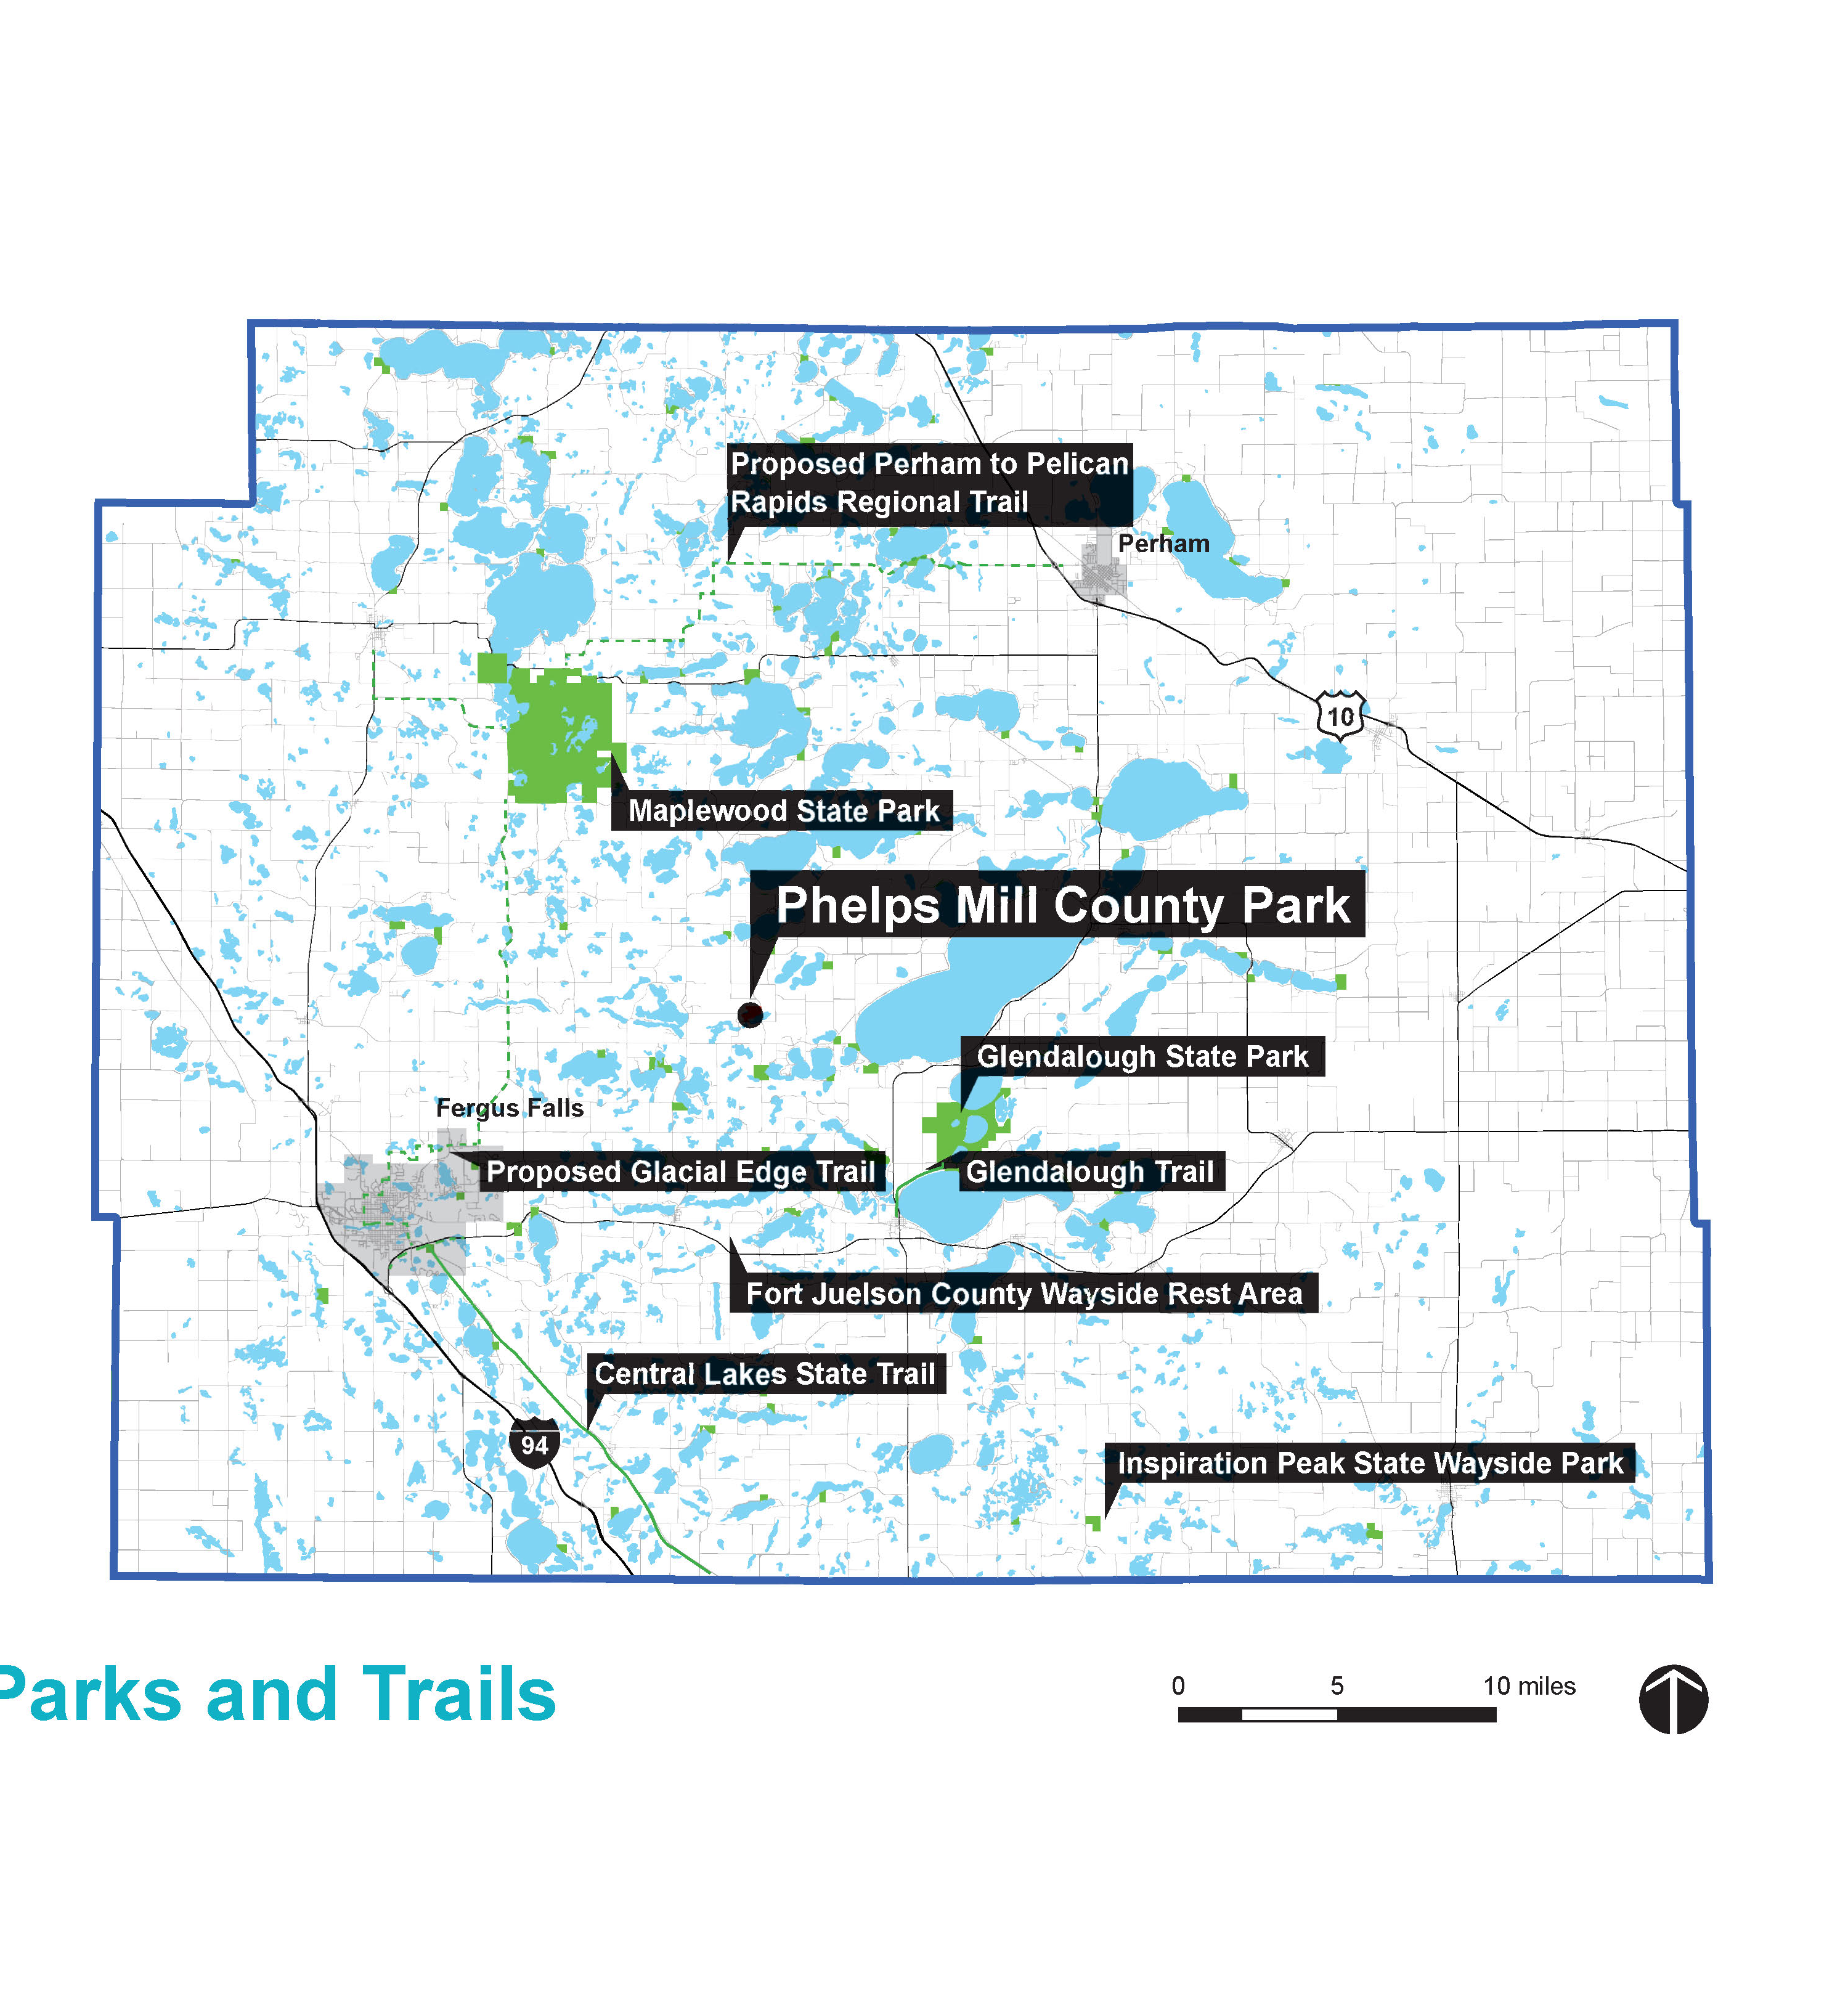
Project Overview
Acquired original 55 acre park in 1965
Original park included Phelps Mill Historic District
In 2019, and addition 72 acres was purchased
Master plan will provide vision and direction for future development of the 127 acre county park.

Slide 3
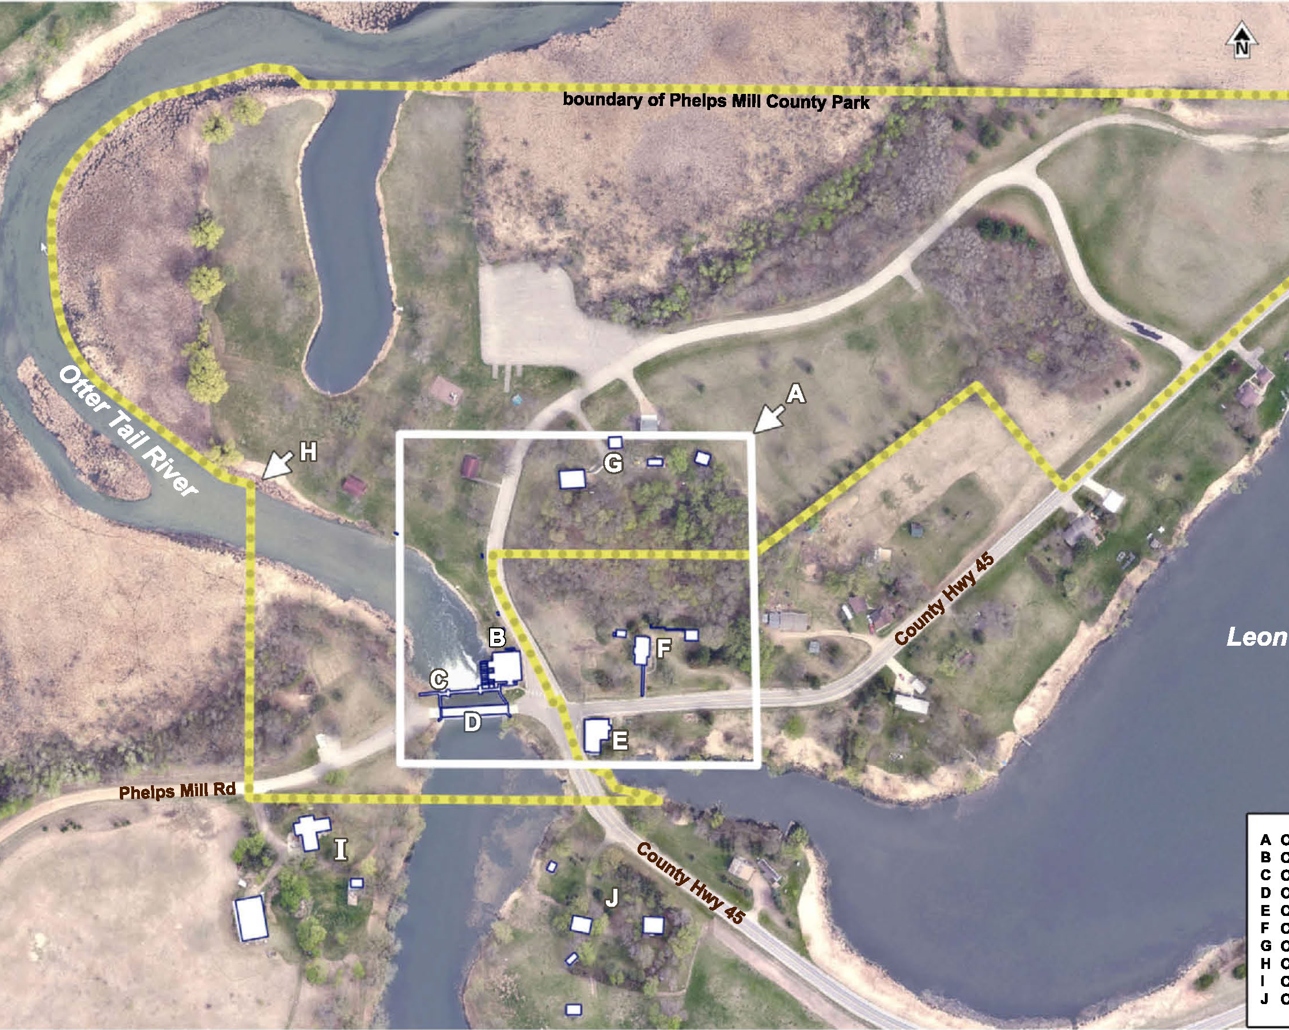
Site Information
Located in central Otter Tail County
Landscape of lakes, woodlands, wetlands and hills
Western boundary is bordered by Otter Tail River
Existing park has several standard park amenities (playground, picnic tables, basic restrooms, parking)
Two areas of the park are developed (Historic Mill district and farmstead)

Slide 4
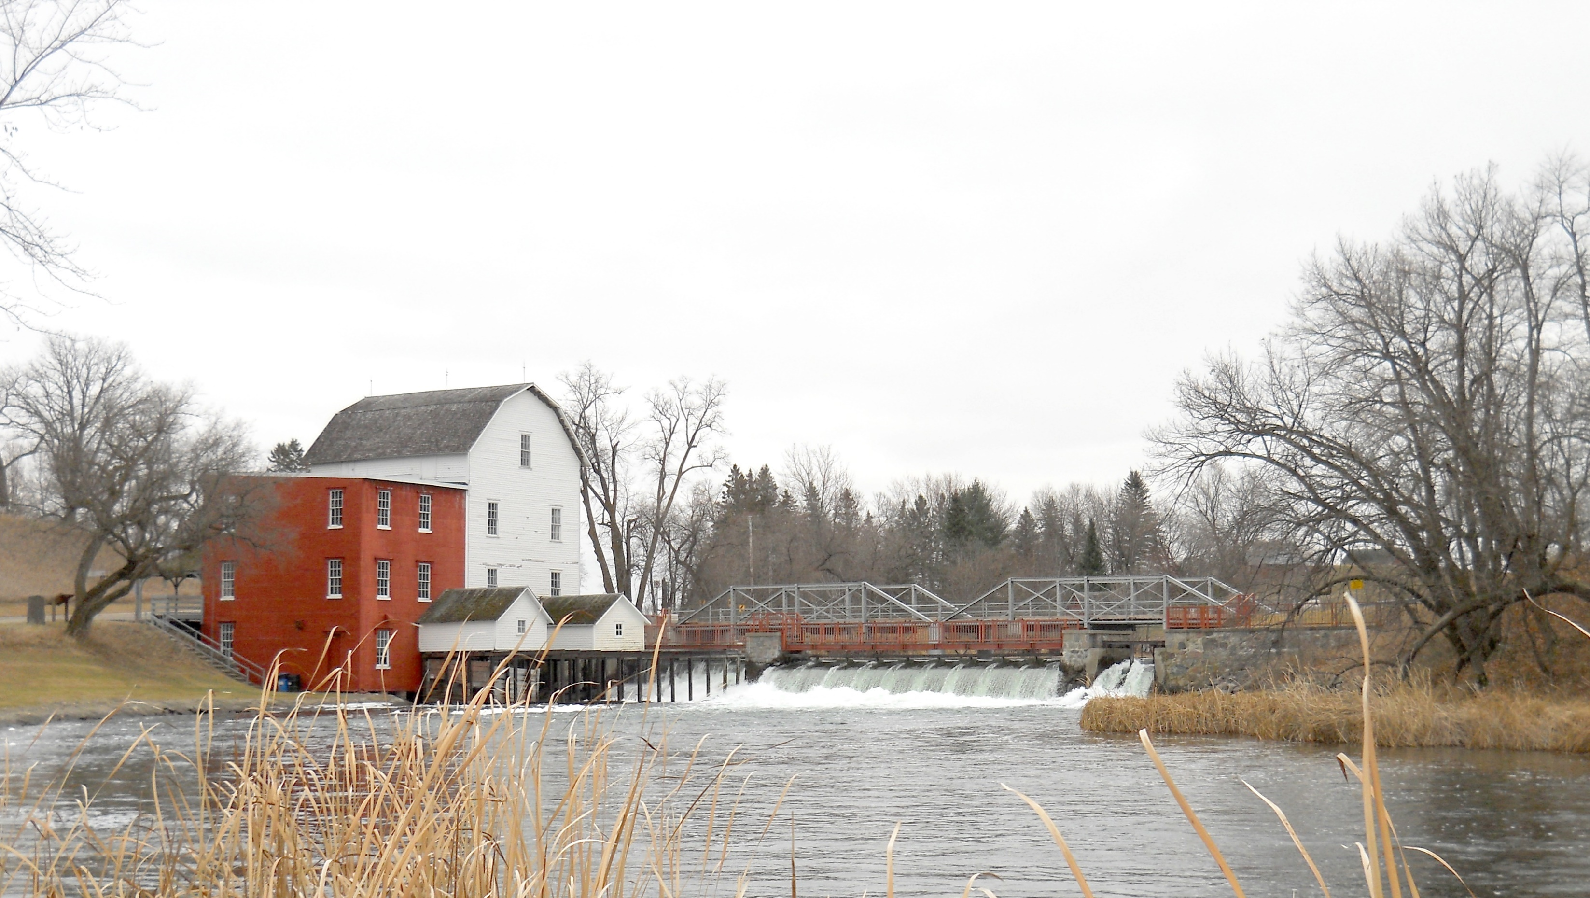
Vision
Phelps Mill County Park provides high-quality outdoor recreation opportunities in a beautiful natural setting and offers visitors the opportunity to experience and learn about grain milling and old-time ways of life through the Phelps Mill Historic District.

Slide 5
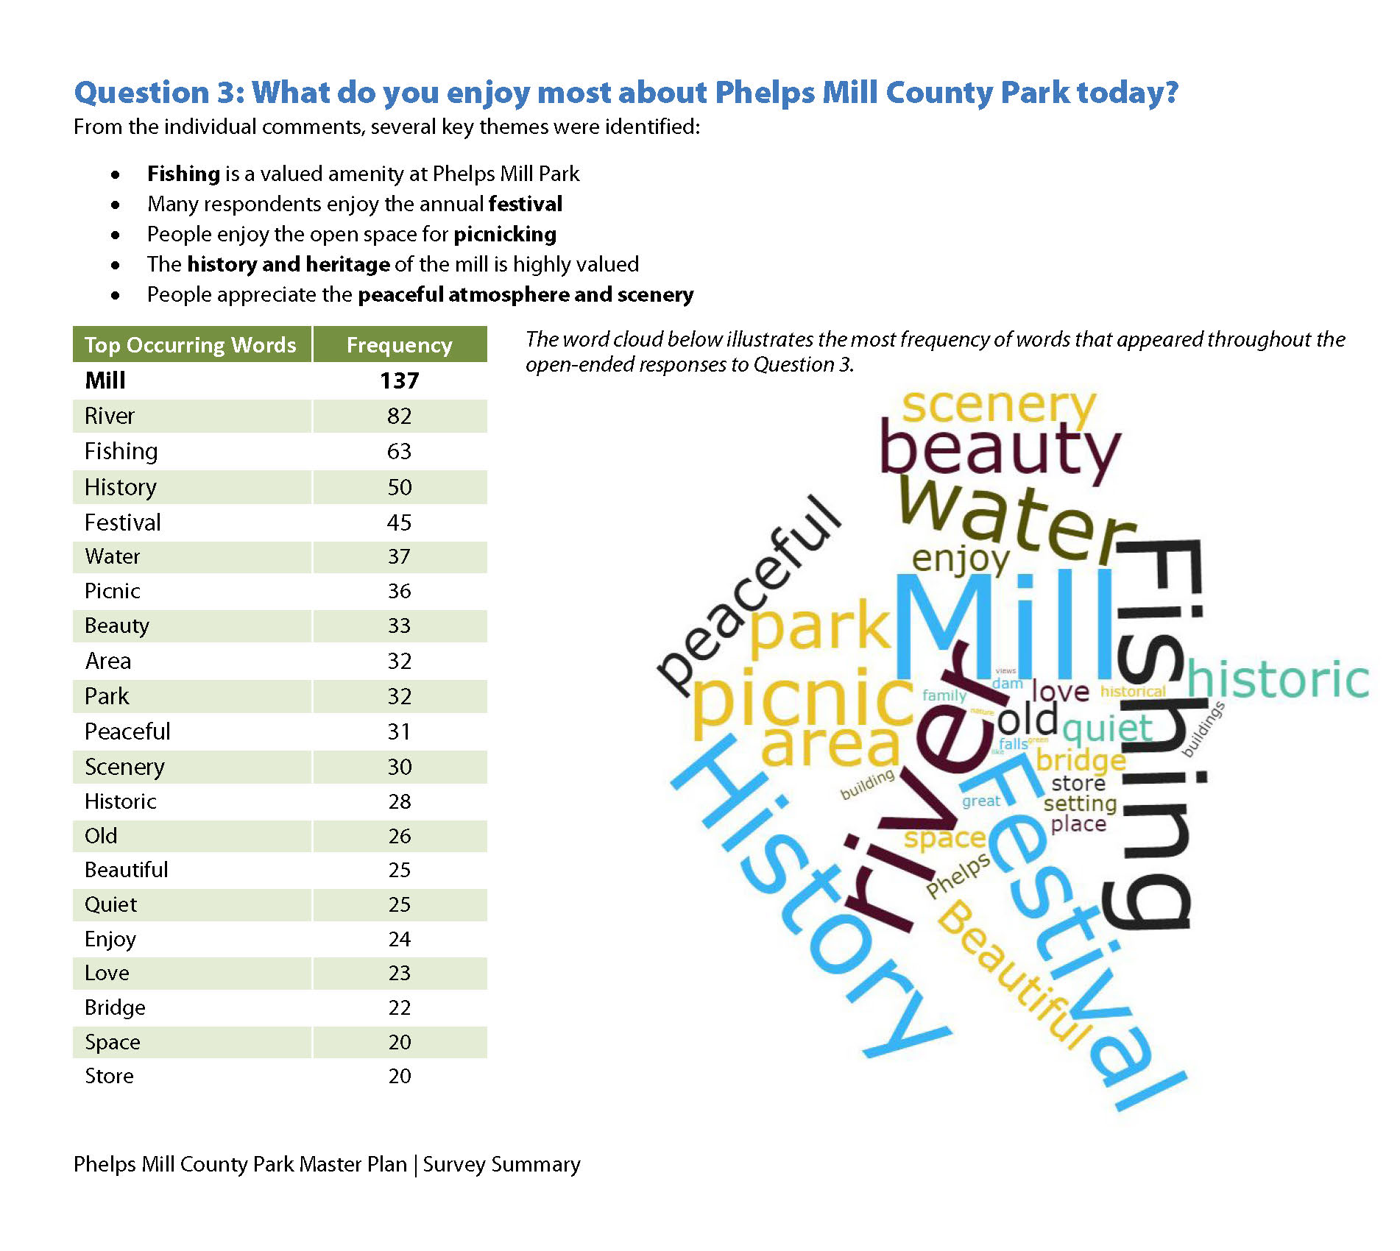
Public Input
Steering Committee
  Review concepts and provide feedback through planning process
Public open house
  Over 50 people attended
  Themes:
    Provide access to the Historic Mill
    River access and canoe camping
    Convert agricultural land to native landscapes
    Develop soft surface trails
    Add winter trails
Two online surveys

Slide 6
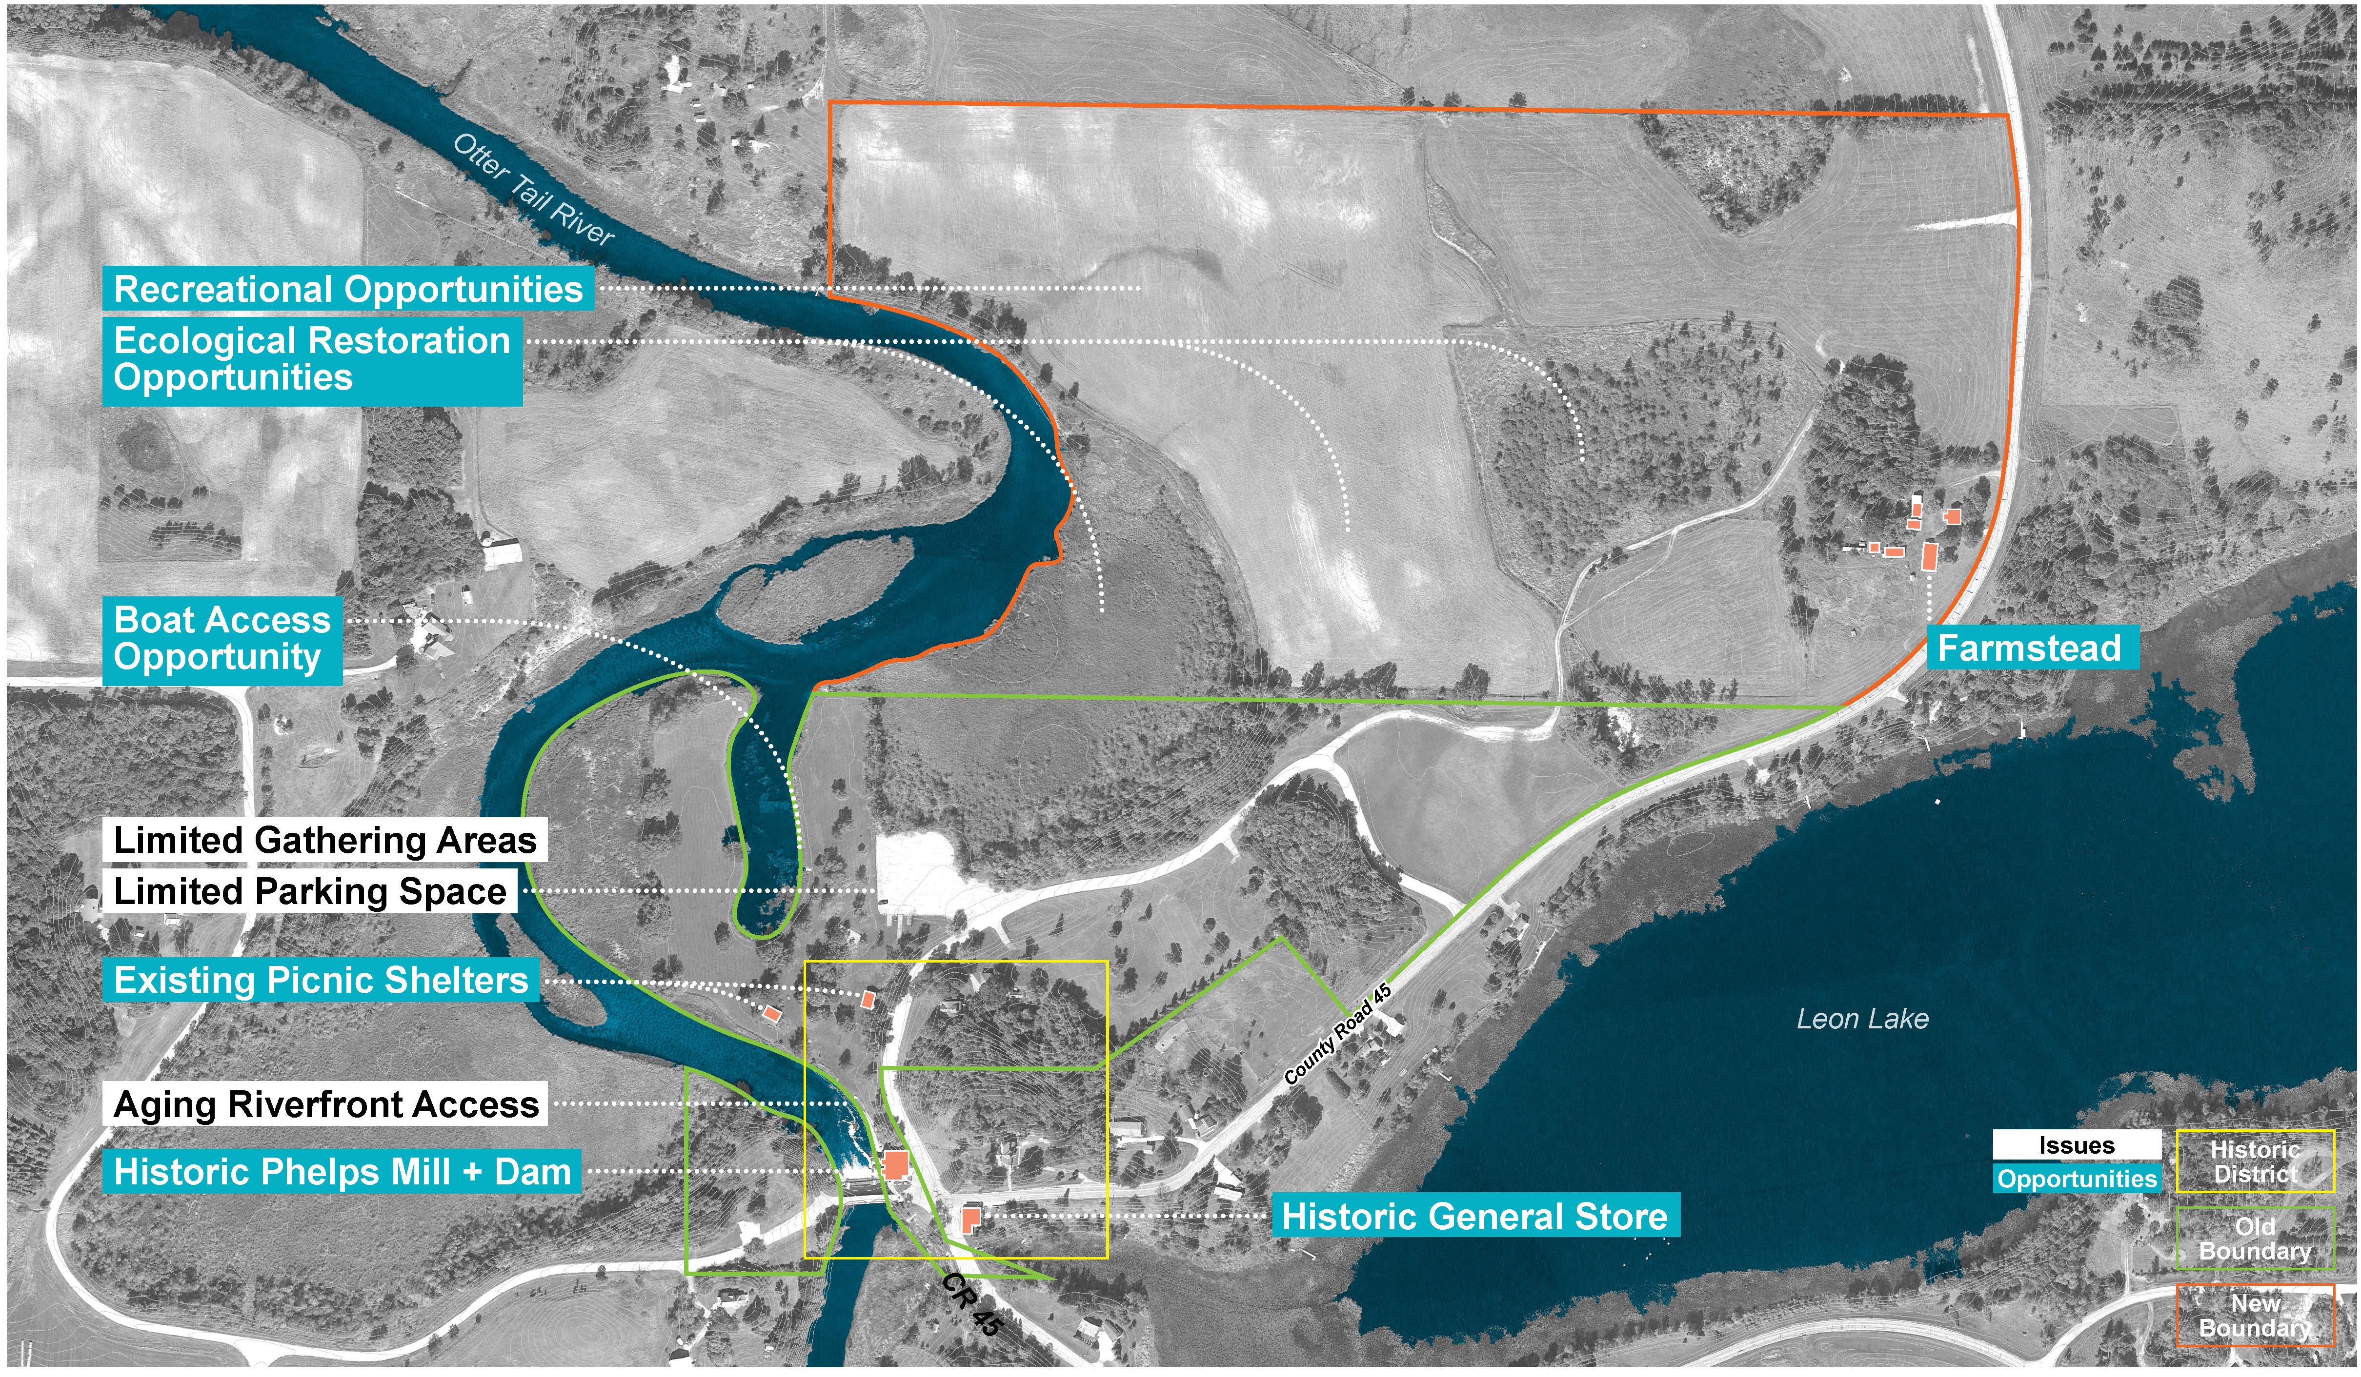
Issues and Opportunities

Slide 7
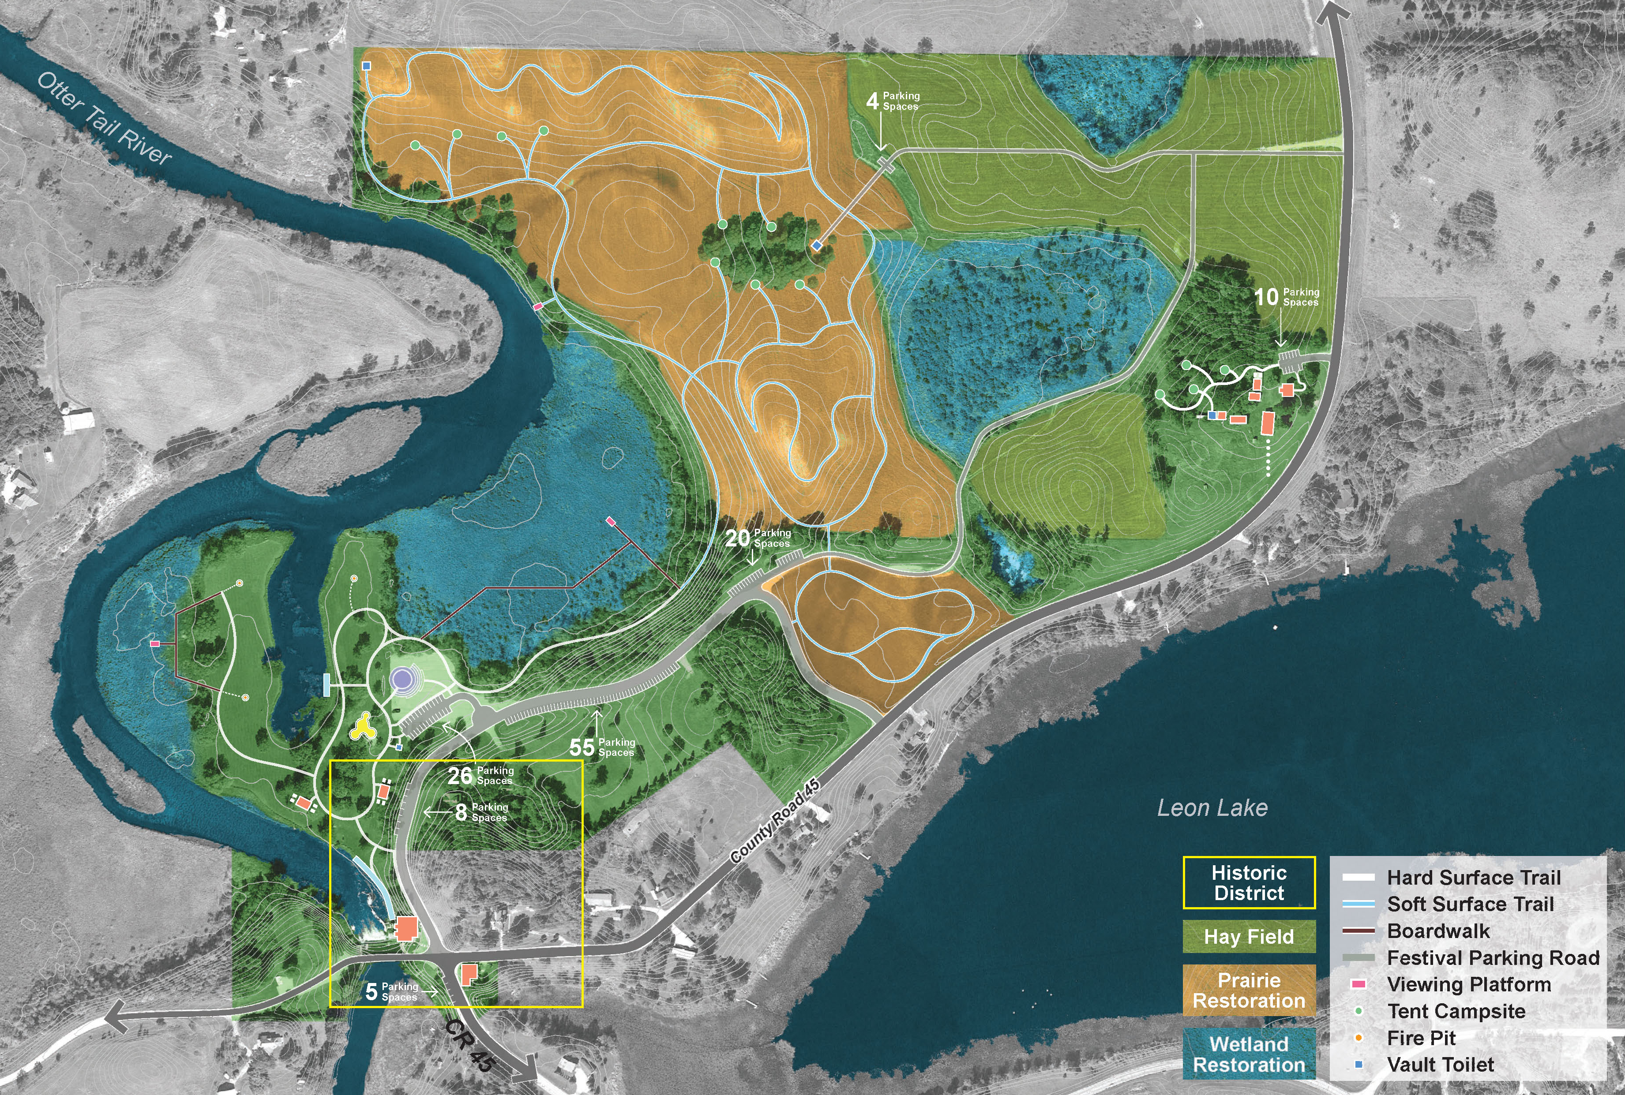
Development and
Master Plan
Improvements:
  Enhanced water access
  Improved picnic and restroom facilities
  Expanded nature play area
  Large gathering areas
  Camping facilities
  Ecological restoration
Parking/Green Infrastructure
Trails and Boardwalks

Slide 8
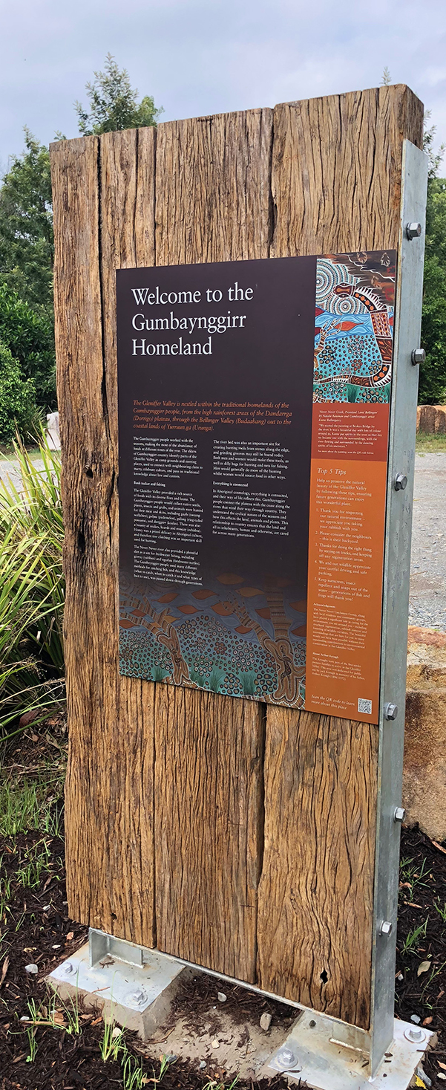
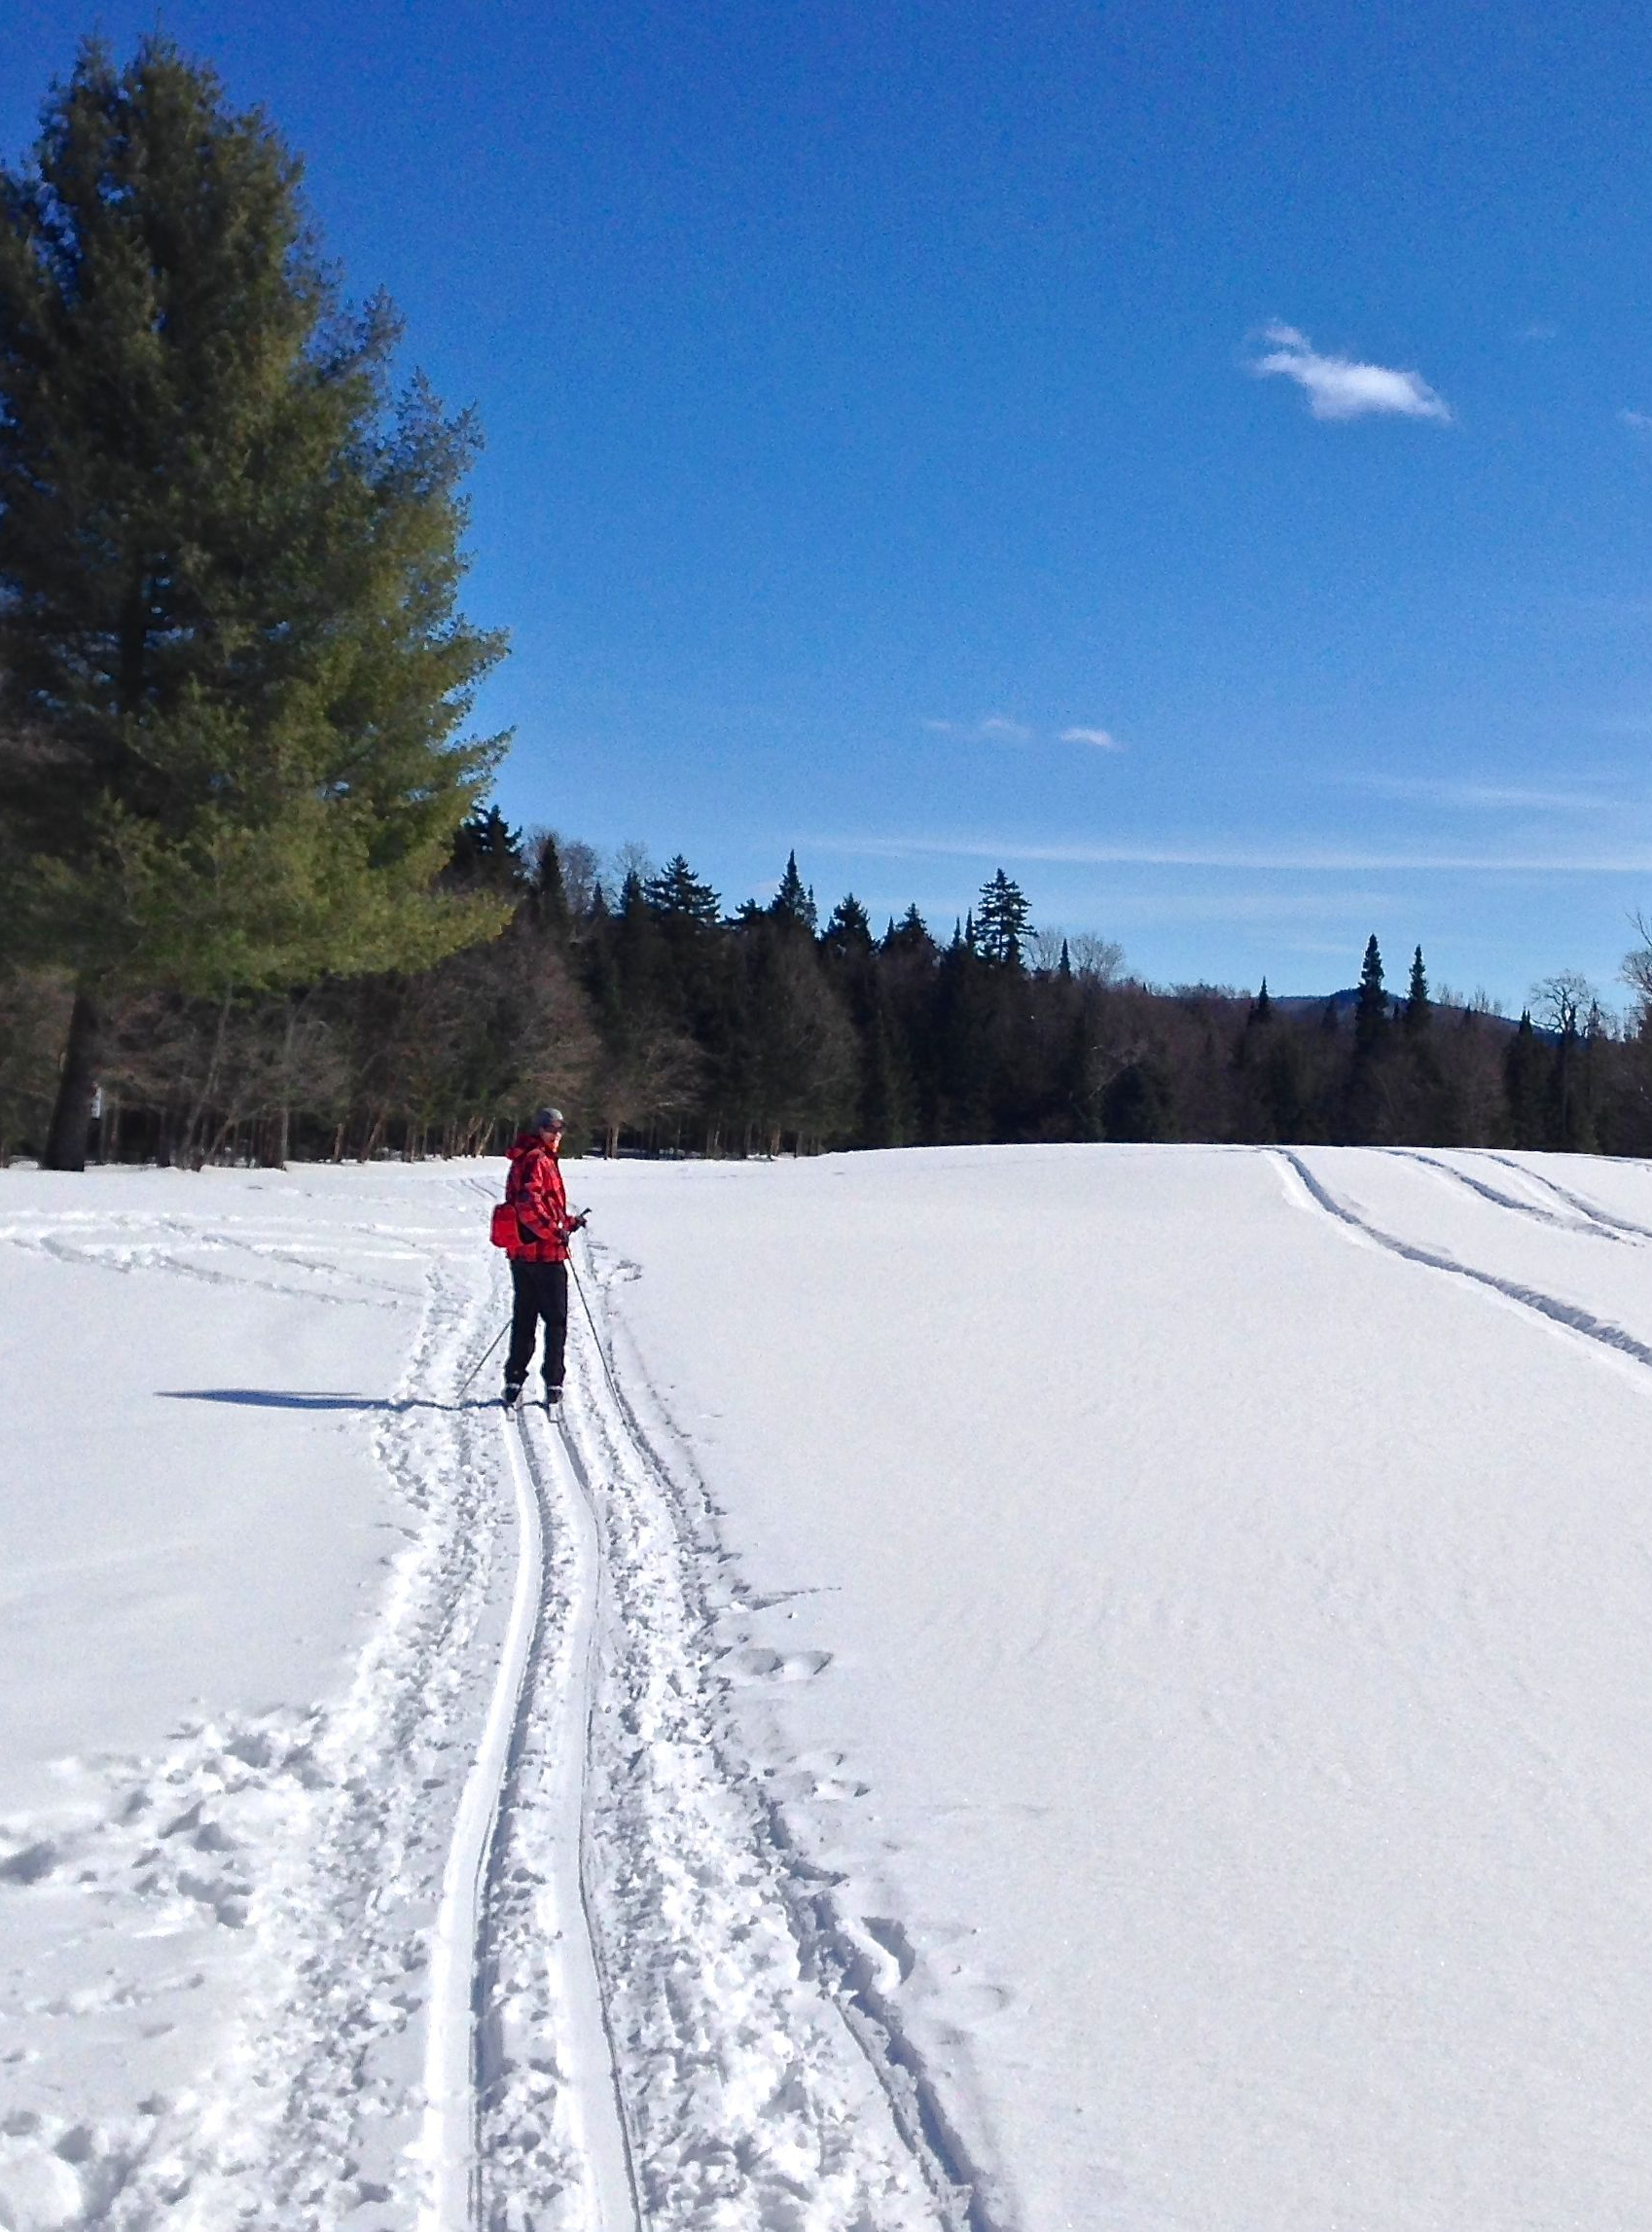
Interpretation and
Programming
Interpretation
  Historic District
  Signage
  Recreation Opportunities
Green infrastructure
  Stormwater Best Management Practices (BMP’s)
  Opportunity for interpretation
Rentals
  Canoe, kayak and paddleboard
  Exploration of Otter Tail River

Slide 9
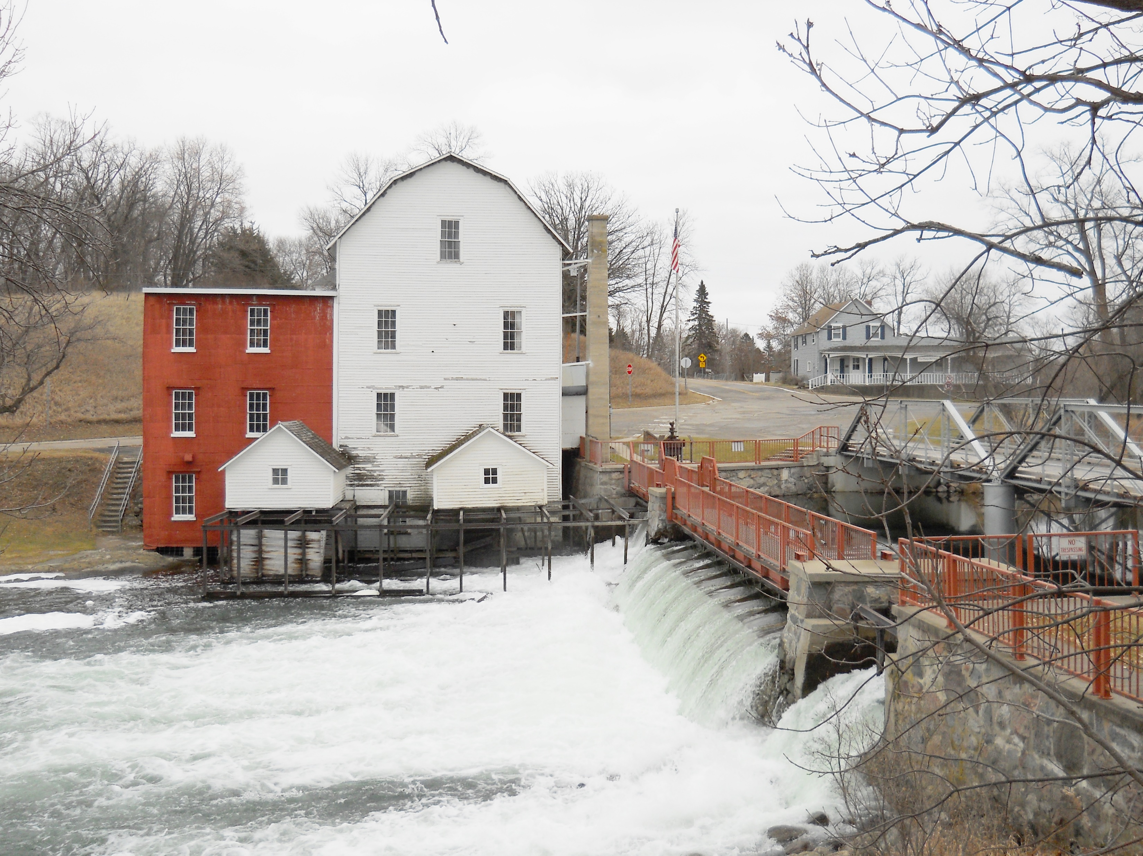
Implementation, Management and Sustainability Plan
Natural Resource Management
  Additional field work to assess the quality of natural resources and their needs.
  Due to size of park, additional funding will be needed to ensure proper management
Cultural Resource Management
  Maintaining structures for daily or periodic use
  Seek input and assistance of a historical architect to guide maintenance and future restoration of historic structures
Site Management
  County Highway Dept. should maintain access along Cty Rd 45
  County staff should maintain park buildings, restrooms and open buildings for group rentals
  Otter Tail County ordinances and regulations should be followed at park. Sheriff should patrol park on a periodic basis
Public Involvement for Implementing Master Plan
  Additional public involvement will be needed for implementation of many initiatives identified in Master Plan.

Slide 10
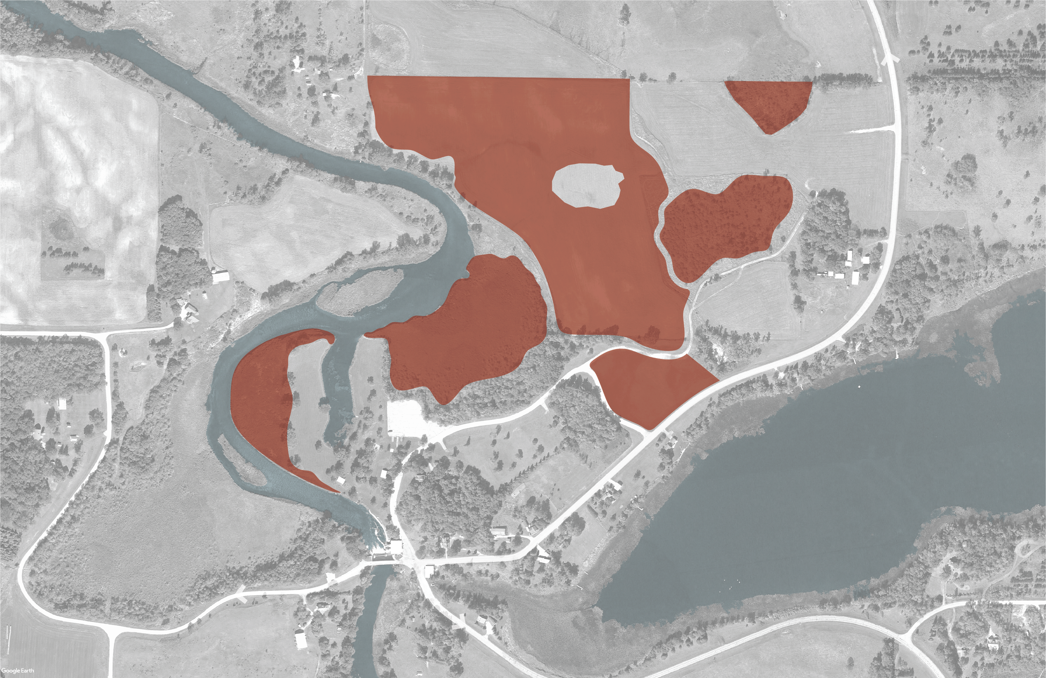
Implementation and Phasing| Phase I
Wetland and prairie restoration
Estimated Cost: $769,000

Slide 11
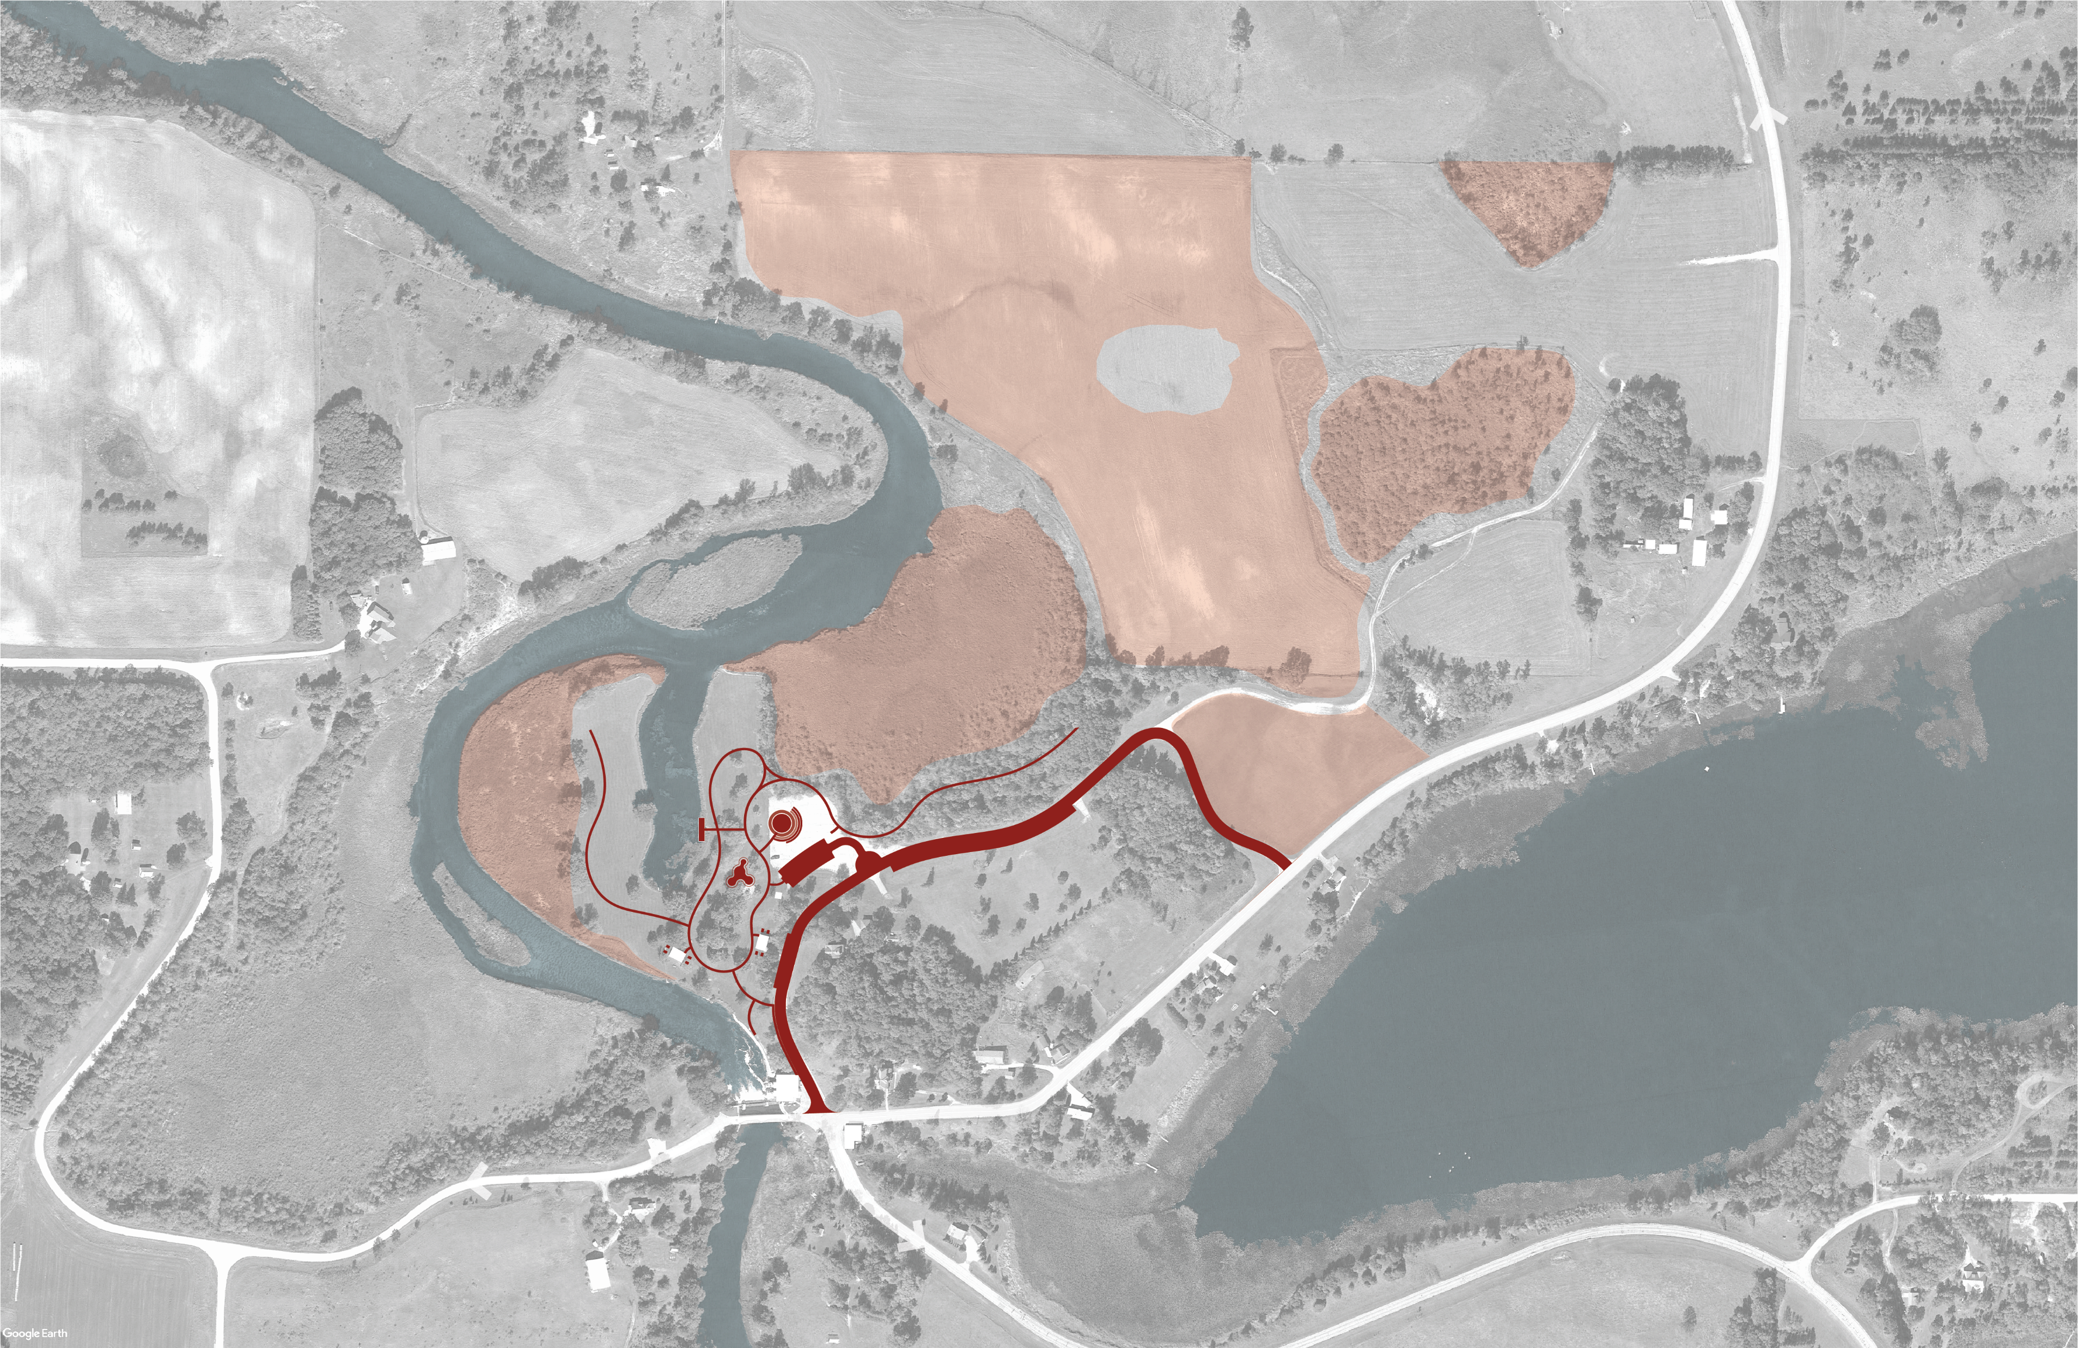
Implementation and Phasing| Phase II
Natural play area
Water access at Phelps Mill and canoe launch/pier
Parking improvements
Large gathering area
Hard surface trails
Interpretive & wayfinding Signage
Estimated Cost: $2,123,000

Slide 12
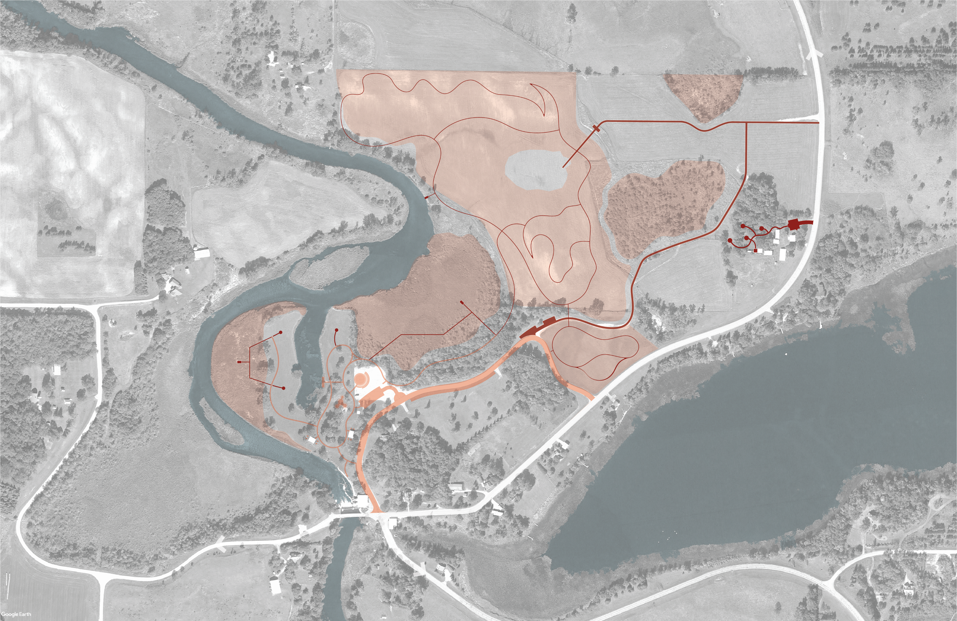
Implementation and Phasing| Phase III
Overflow parking infrastructure
Phase I camping development (River location and all-abilities at the Farmstead) including one vault toilet
Soft surface trails
Boardwalk and viewing platforms
Estimated Cost: $3,508,000

Slide 13

Implementation and Phasing| Phase IV
Phelps Mill improvements
General Store improvements
Farmstead improvements
Phase II camping development (hike-in sites and vault toilet)
Estimated Cost: $467,000

Slide 14
Funding Opportunities
GMRPTC (designation application submitted)
LCCMR (restoration grant submitted for Phase 1)
State Capital Projects Grants-in-Aid
Minnesota Historical and Cultural Heritage Grants

