Slide 1
Lida Lakes
LID Proposal
Lake Lida Property Owners Association

Slide 2
Lake Lida Property Owners Association (LLPOA)
Non-profit organization
Includes North Lida, South Lida, and Venstrom Lakes
Voluntary membership of 400 (+/-) members
Organized by beaches with designated Beach Captains
Objectives are to maintain/improve:
  Water quality
  Habitat
  Fishing
  Recreation
  Property Value

Slide 3

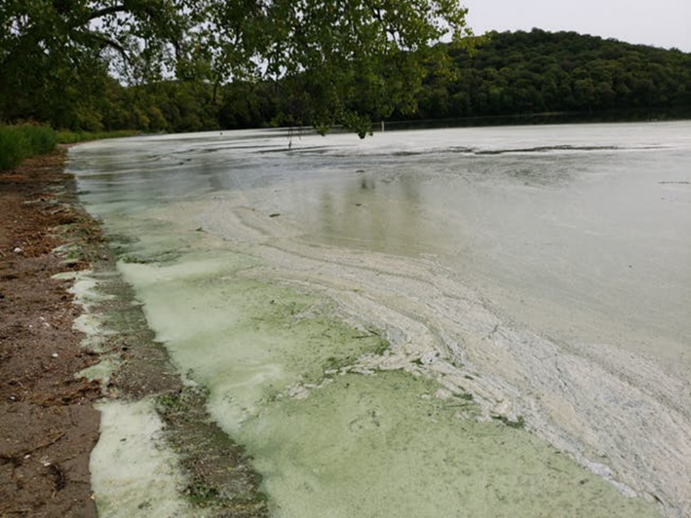
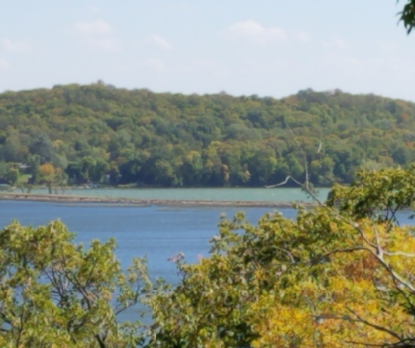
Recent Issues
2018 algae bloom (South Lida)
Likely causes:
  Curly leaf pondweed (CLP)
  Zebra mussels
  Sustained high water temperature
  Prolonged low wind conditions
POA moved forward with CLP treatment

Slide 4
CLP Treatment Program
Treatment competed in 2019, 2020, and 2021 (South Lida only)
Contract services for CLP surveys
Applied for permits with MN DNR
Prioritize treatment in allowable areas
Contract services for CLP treatment
Continued treatment needed to manage CLP levels
Note – Credit to David Hilber for volunteering his time to accomplish this!

Slide 5
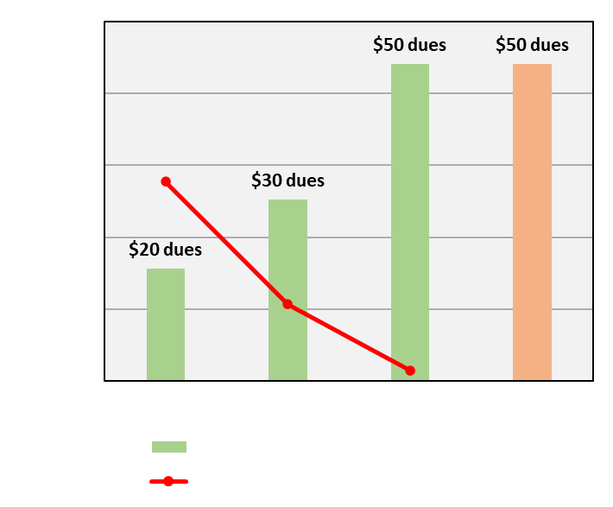
CLP Treatment Financing
Treatment is funding limited
Budget surplus used for treatment
Annual dues increased annually
Spending continues to exceed revenue
Funding limited for other issues

Slide 6
Lake Improvement District (LID)
Consistent Budget
Increased Management Ability
Maintained/ Increased Quality of our Lakes
$50,000 proposed budget
Access to Grant Funds
Consistent Revenue
Resident surveys
CLP treatment
Address future lake issues
Recreation/Fishing
Water Quality
Quality of Life
Operated by Lake Residents
Notes:
Emphasize still run and operated by property

Slide 7
Proposed Lake Management Programs
Water Quality Evaluation
Aquatic Invasive Species Treatment
Promote Better Management Practices
Promote Sustainable Uses
Advocate for Lake Issues
Promote Capital Improvement Projects that Enhance Water Quality
Public Education of Lake Residents

Slide 8
Proposed Budget
$50,000 Annually (Estimate; Directors set at annual meeting)
Primary focus on AIS treatment (CLP) initially
Administrative costs required for operation of LID
Contracted Services (Lake Coordinator)
    Coordinate requirements for state agencies
    Oversee contracted lake treatment
    Knowledge of available Grants, Permitting, Surveys, etc…
    Meet legal requirements for organized LID
Notes:
Reinforce need for Contracted Services for Lake Coordinator for liability, accountability

Slide 9
Typical Statutory Funding Options
Assess project costs based on benefits provided
Impose flat rate based on services provided
Ad valorum levy based on property value
Project financing through issuance of obligations (ex. Bonds)
Any combination there-of
Note – LLPOA current dues structure closest matches a Flat Rate for current Curly Leaf Pondweed Treatment
Notes:
LLPOA dues are based on current situation.

Slide 10
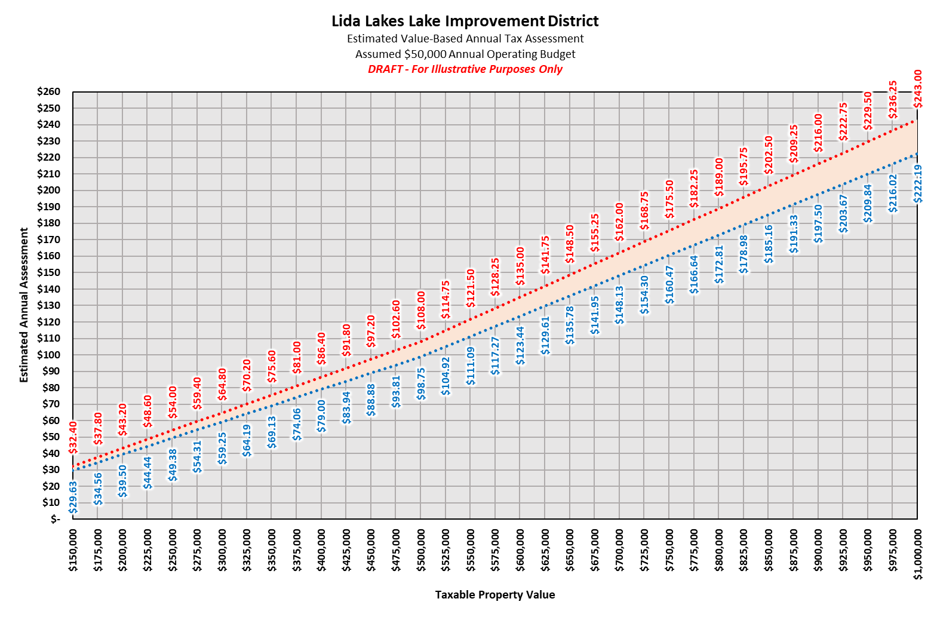
Notes:
LLPOA – flat rate in past… wanted a flat rate… we thought we had to do ad valorum levy… further research indicated that flat rate is available for services provided (such as CLP)

Slide 11
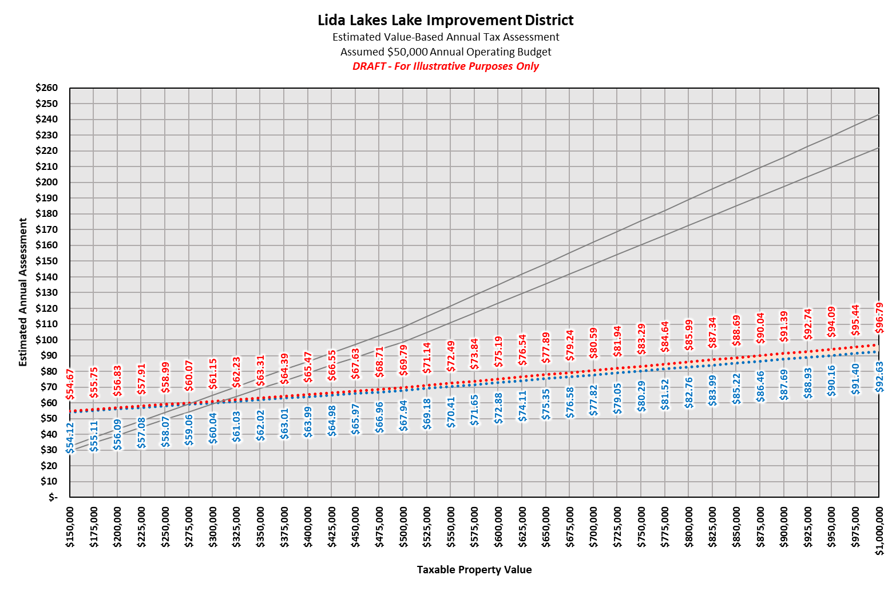
Example:
$500,000 Value
$70 (+/-) estimated LID tax
Notes:
LLPOA – flat rate in past… wanted a flat rate… we thought we had to do ad valorum levy… further research indicated that flat rate is available for services provided (such as CLP)

Slide 12
How would the LID be funded?
Service based (flat rate) fee for continued AIS treatment (est. 80% of budget)
Ad Valorum levy for flexibility to investigate other lake issues (est. 20% of budget)
Fixed total budget (IE… budget does not go up with increasing property value)
Does not include the MN State Park – LID is not able to tax state lands
Note – The LID Directors will set the budget during their annual meeting.
Notes:
LLPOA dues are based on current situation.

Slide 13
Local Tax/Local Control
Governing Board consists of 7 Directors
Directors must be LID members, majority permanent residents
Directors elected at annual meeting by LID members
3-year term, staggered election
Annual budget set at annual meeting
Annual meeting is open for any residents to of the LID to attend
Local Tax → Local Control → Local Benefits

Slide 14
Why is this necessary?
LLPOA is a voluntary organization that is funding limited
Consistent revenue to address current and future lake issues
Leverage local funds for outside funding that the LLPOA cannot
Transparency on expenditures
Keep taxes local and invested directly into the Lake
Local control over lake management

